Slide 1

MCTS Guide to Microsoft 7
Chapter 2
Installing Windows 7

Slide 2
Objectives
Describe the deployment enhancements in Windows 7
Choose a method for installation
Choose a type of installation
Use Windows Easy Transfer
Perform an attended installation of Windows 7
Perform an unattended installation of Windows 7
Use and manage Windows Imaging Format image files

Slide 3
Deployment Enhancements in Windows 7
Enhancement categories in corporate environments
  Design improvements
  Tool and technology improvements

Slide 4
Design Improvements
Modularization
  Implemented behind the scenes in Windows 7 code
  Benefits
    Simplified addition of drivers and other updates
    Simplified development of service packs
    Simplified implementation of multiple languages
Windows Imaging Format
  Installation is done from a Windows Imaging Format (WIM) image file

Slide 5
Design Improvements (cont'd.)
Windows Imaging Format benefits
  Add and remove components directly from image file
  Add updates directly to image file
  Add and remove files directly from image file
  Single image for multiple hardware platforms
  Single image file for multiple images with varying configurations

Slide 6
Design Improvements (cont'd.)
XML-Based Answer Files
  Windows 7 uses a single XML-based answer file to perform automated installations
  Windows System Image Manager (WSIM)
    Create and edit answer files for Windows 7 installation
Installation Scripts
  Can be used to automate installation tasks
    Ensures they are performed same way each time

Slide 7
Design Improvements (cont'd.)
File and Registry Redirection
  Some applications attempt to write information to the Windows folder or restricted parts of the registry
  Requests are redirected to a virtual Windows folder or virtual registry location
  “Tricks” the application into running
    Without requiring users to have elevated privileges

Slide 8
Tools and Technology Improvements
Application Compatibility Toolkit
  Helps organizations quickly identify which applications are compatible with Windows 7
User State Migration Tool
  Moves desktop settings and applications from one computer to another
ImageX
  New command-line tool for managing WIM images
  Included in the Windows Automated Installation Kit (WAIK)

Slide 9
Tools and Technology Improvements (cont'd.)
Windows System Image Manager
  Graphical tool for configuring unattended installs creating distribution shares
Windows PE
  Limited and non-GUI version of Windows based on Windows 7 technologies
  Can be used for installing, troubleshooting, and repairing Windows 7
  Includes networking components
    Can use current Windows drivers for network connectivity

Slide 10
Tools and Technology Improvements (cont'd.)
Deployment Image Servicing and Management (DISM)
  Used to perform offline servicing of WIM images
Windows Deployment Services (WDS)
  Updated version of Remote Installation Services (RIS)
  Server side component that can be used to manage the deployment of images over the network
  Desktop computers can be booted to the network
    Using a Preboot eXecution Environment (PXE) network card to perform an installation

Slide 11
Windows 7 Installation Methods
Most common installation Windows 7 methods
  DVD boot installation
  Distribution share installation
  Image-based installation

Slide 12
DVD Boot Installation
Least suitable method for large volume of computers
Suitable for small organizations that only occasionally install Windows 7
Degree of customization is low
  Includes only the drivers and components included on the Windows 7 installation DVD
  You can add drivers using any external storage media

Slide 13
Distribution Share Installation
Requires computers to be booted into Windows PE from removable storage
  Then run installation from a distribution share
Speed of a distribution share installation varies
  Files must be transferred across the network
Level of customization for a distribution share installation is higher than a DVD boot installation
  Distribution share can be customized by WSIM or ImageX

Slide 14
Image-Based Installation
Requires the creation of a customized image that you apply to each computer
  Customized image is created using ImageX
    And placed on a distribution share by using WSIM
Requires computers to be booted into Windows PE
  Then copying the customized image onto computer
Fastest type of installation
Highest level of customization is achieved by using image-based installations

Slide 15
Windows 7 Installation Types
Types of installations
  Clean installation
  Upgrade installation

Slide 16
Clean Installations
Most installations are clean installations
A new computer always has a clean installation
Network administrators in corporate environments often prefer clean installations
Hard drive is usually wiped out and reformatted
Clean installations can be performed by any installation method

Slide 17
Upgrade Installations
Also referred to as an in-place migration
Migrate the user settings, files, and applications that exist in the previous operating system
  To the new operating system on the same computer
Only Windows Vista with at least Service Pack 1 can be upgraded to Windows 7
Main benefit is the time saved by automatic migration of user settings, files, and applications
Potential downside is less stability on an upgraded computer

Slide 18
Migrating User Settings and Files
Windows 7 stores user settings in user profiles
  Stored as a folder in the C:\Users\directory
During an upgrade to Windows 7
  Profiles are automatically upgraded and settings within the profile are retained
Tools to migrate user settings and files
  Windows Easy Transfer (graphical utility)
    Migrates settings and files from one computer at a time
  User State Migration Tool (command-line utility)
    Uses scripts to migrate settings and files

Slide 19
Dual Boot Installations and Virtualization
Dual boot installation
  When two operating systems are installed on the same computer and you can switch between them
Boot loader of an operating system must support dual boot installations
Boot loader
  First component loaded from the hard drive during the boot process
  Responsible for starting the operating system

Slide 20
Dual Boot Installations and Virtualization (cont'd.)
Dual booting is typically required for two purposes
  Using unsupported applications
  Keeping configuration data separate
Windows 7 can perform a dual boot with almost any operating system
Main requirement
  Disk partition separate from other operating systems
Virtualization software
  Uses the main operating system as a host to run as many guest operating systems as you need

Slide 21
Dual Boot Installations (cont'd.)
Virtualization software advantages
  Faster access to other operating systems
  Multiple virtual machines at the same time
  Simpler disk configuration
  Snapshots and undo disks
  Virtualized hardware

Slide 22
Windows Easy Transfer
Graphical application for migrating settings and files from one computer to another
Windows Easy Transfer can migrate:
  User accounts
  Folders and files
  Program settings
  Internet settings and favorites
  E-mail settings, contacts, and messages

Slide 23
Windows Easy Transfer (cont'd.)
Using Windows Easy Transfer requires four steps
  Copy Windows Easy Transfer to the old computer
  Select a transfer method
  Select what to transfer
  Transfer user settings and files to the new computer

Slide 24
Copy Windows Easy Transfer
You can copy Windows Easy Transfer to:
  CD, DVD, USB flash drive, tape drive, external hard disk, or a shared network folder
    Can be run directly from that location
On the destination computer
  Windows Easy Transfer stays up and running to accept information from the source computer
    Required if you are transferring user settings and files directly over the network or by using a USB cable

Slide 25
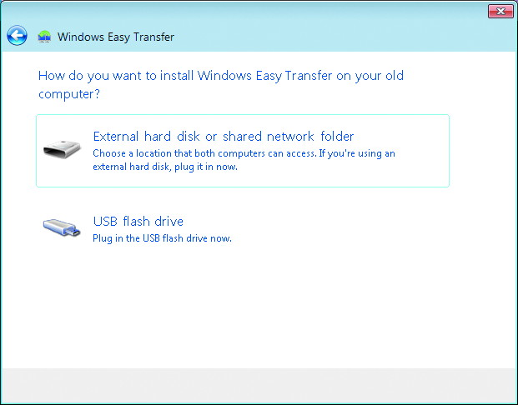

Slide 26
Select a Transfer Method
To migrate user settings and files:
  Run Windows Easy Transfer on Windows XP or Windows Vista
  Windows Easy Transfer cannot migrate system and program settings from Windows 2000
Options for transferring user settings and files
  Use an Easy Transfer Cable
  Transfer directly, using a network connection
  Use an external hard disk or USB flash drive

Slide 27
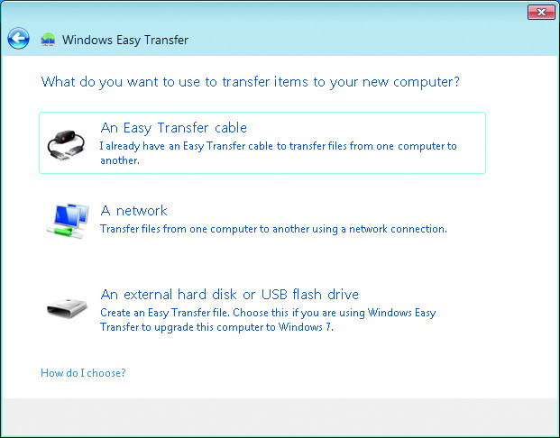

Slide 28
Select What to Transfer
Options for what to transfer
  All user accounts, files, and settings
  Single user account, files, and settings
  Advanced options
You have the option to secure the data being transferred with a password

Slide 29
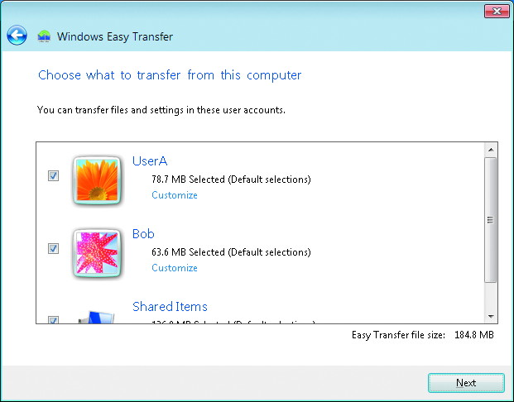

Slide 30
Transfer User Settings and Files
Steps
  Enter the encryption password to protect the transferred data, if desired
  Specify the location of the MIG file
  Match the user accounts on the old computer with existing accounts on the new computer, or create new user accounts on the new computer
  Begin the transfer

Slide 31
Attended Installation
Manually start and perform the installation
Start the installation by running Setup.exe
Much improved over Windows XP
  Windows 7 minimizes user involvement during installation
  You enter information only at the very beginning and very end of the installation

Slide 32
Product Activation
Process put in place by Microsoft to reduce piracy
If an installation is not activated within 30 days
  Activation dialog box appears
  Desktop background changes to solid black
You can activate Windows 7 from the System applet in Control Panel

Slide 33
Product Activation (cont'd.)
Product key used during installation is associated with the specific computer that is performing the activation
  If you perform significant hardware changes to your computer, you may be forced to reactivate Windows
Volume license agreement allows for two types of keys:
  Multiple Activation Key (MAK)
  Key Management Service (KMS)

Slide 34
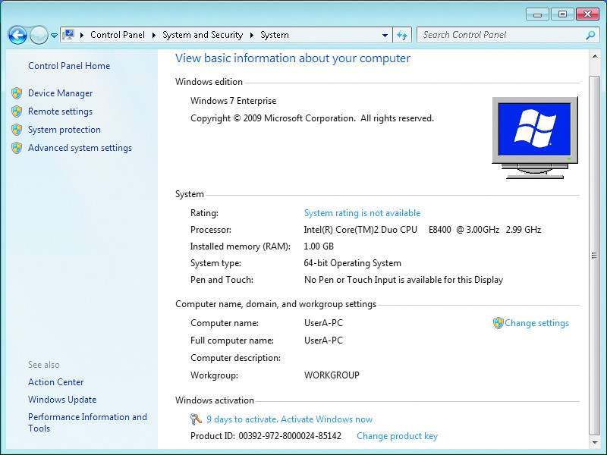

Slide 35
Unattended Installation
Unattended installations do not require administrator intervention
  Entire process can be automated using an answer file
Answer file
  XML file that contains settings used during the Windows installation process
Unattended installations are faster than attended installations
  More consistent because same answer file is used
Gives you a wider range of configuration options

Slide 36
Answer File Names
You can:
  Specify the name of the answer file
  Or allow Setup to find the answer file automatically
    Using the /unattend switch when you run setup
Answer files cached in the %WINDIR%\panther directory
  Are reused during later actions that look for an answer file

Slide 37
Answer File Names (cont'd.)
Configuration Pass | Answer File Name
windowsPE | Autounattend. Xml
offlineServicing | Autounattend. Xml
Specialize | Unattend. xml
Generalize | Unattend. xml
AuditSystem | Unattend. xml
AuditUser | Unattend. xml
oobeSystem | Unattend. xml

Slide 38
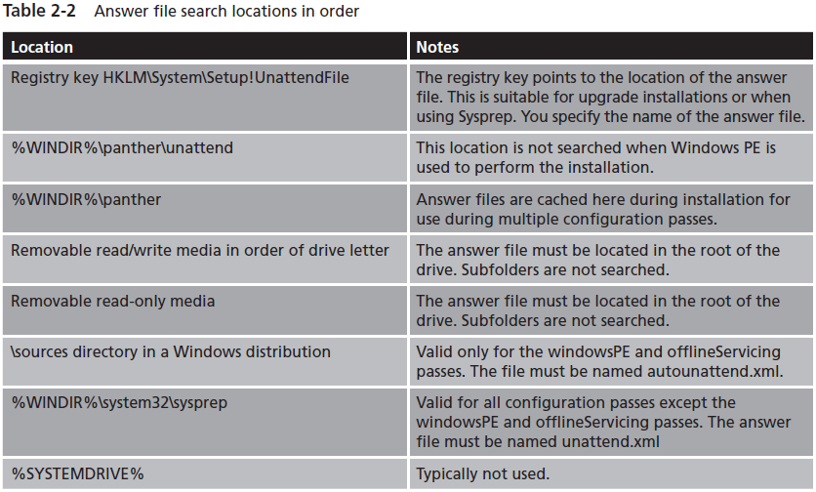
Answer File Names (cont'd.)
Found on page 69 in book

Slide 39
Configuration Passes for a Basic Installation
Windows 7 still has multiple phases of setup
  Single answer file is used for all configuration passes
The windowsPE Configuration Pass
  Used at the start of the installation to:
    Partition and format the hard disk
    Specify a specific Windows image to install
    Specify credentials for accessing the Windows image
    Specify the local partition to install Windows 7 on
    Specify a product key, computer name, and administrator account name
    Run specific commands during Windows Setup

Slide 40
Configuration Passes for a Basic Installation (cont'd.)
The offlineServicing Configuration Pass
  Used to apply packages to a Windows 7 image
    After it is copied to hard drive, but before it is running
  Benefits
    Faster installation
    Enhanced security
The specialize Configuration Pass
  Applies a wide variety of settings related to the Windows interface, network configuration, and other Windows components

Slide 41
Configuration Passes for a Basic Installation (cont'd.)
The oobeSystem Configuration Pass
  Applied during the user out-of-box experience (OOBE)
    Portion of the installation where users are asked for information after the second reboot
Sysprep Configuration Passes
  Sysprep utility is used to manage Windows 7 installations that are imaged
  Configuration passes that can be triggered by Sysprep
    The generalize configuration pass
    The auditSystem configuration pass and auditUser configuration pass
    The oobeSystem configuration pass

Slide 42
Configuration Passes for a Basic Installation (cont'd.)
Basic
Installation
Sysprep
(optional)
WindowsPE
(optional)
offlineServicing
generalize
(optional)
specialize
specialize
auditSystem
(optional)
auditUser
(optional)
oobeSystem
oobeSystem

Slide 43
Windows System Image Manager
Allows you to create and modify answer files that are used for unattended installations
Common tasks you can perform with WSIM include:
  Create or update an answer file
  Add device drivers or applications to an answer file
  Create a configuration set
  Apply offline updates to a Windows image
WSIM replaces the Setup Manager utility

Slide 44
Windows System Image Manager (cont'd.)
Create or Update an Answer File
  WSIM allows you to create an answer file to control the installation of Windows
Add Device Drivers or Applications
  You must create a distribution share to hold a copy of device drivers you are installing
  Distribution share folders for updating drivers
    $OEM$
    Out-of-Box Drivers

Slide 45
Windows System Image Manager (cont'd.)
Create a Configuration Set
  Configuration set
    Subset of files in a distribution share that are required for a particular answer file
  Best to use a configuration set when workstations cannot access the distribution share
Apply Offline Updates to a Windows Image
  Offline updates are software packages containing drivers, service packs, or security updates
    Applied to an image during the offlineServicing configuration pass of the installation

Slide 46
Image-Based Installation
Corporate environments have been using imaging for many years
  Method to quickly deploy workstation operating systems and applications
Sysprep has long been included as a deployment utility to support third-party imaging software

Slide 47
Image-Based Installation (cont'd.)
Overall imaging process
  Install and configure Windows 7 and applications on a source workstation
  Use Sysprep to generalize the source workstation for imaging
  Boot the source workstation using WindowsPE
  Use ImageX to capture the image from the source workstation and store it in a distribution share
  On the destination workstation, use WindowsPE to connect to the distribution share
  Use ImageX to apply the image in the distribution share to the destination workstation

Slide 48
Sysprep
Generalization
  Preparing workstations to capture an image
  Removes system-specific data from Windows
You can specify an answer file to use during generalization
  Otherwise Sysprep will search for unattend.xml to use as an answer file
System Cleanup Actions
  You must select a system cleanup action
  System cleanup action determines the behavior of Windows 7 after configuration

Slide 49
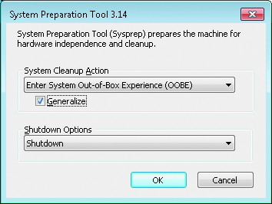
Sysprep (cont'd.)

Slide 50
Sysprep (cont'd.)
System Cleanup Actions (cont'd.)
  Options
    Enter System Out-of-Box Experience (OOBE)
    Enter System Audit Mode
Hardware Abstraction Layer (HAL) can be different on the source and destination computers
Sysprep Limitations
  Drivers must be available to support plug and play hardware of the destination computer
  Sysprep generalization resets the activation clock a maximum of three times

Slide 51
Sysprep (cont'd.)
Perform initial installation
Run Sysprep and select audit mode
Logon to add drivers or applications
Run Sysprep and select OOBE
User starts system and runs OOBE

Slide 52
Sysprep (cont'd.)
Sysprep Limitations (cont'd.)
  Sysprep does not perform imaging operations
  If a computer is a member of a domain, running Sysprep removes the computer from the domain
  Sysprep will not run on upgraded computers
  After running Sysprep, encrypted files and folders are unreadable
Sysprep Command-Line Options
  Sysprep has both a command-line interface and a graphical interface

Slide 53
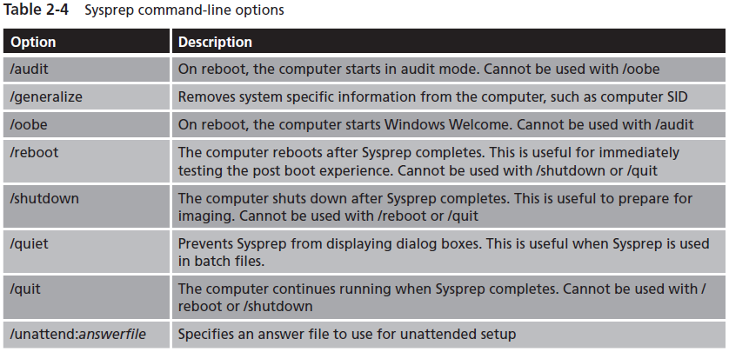
Sysprep (cont'd.)
Found on page 81 in book

Slide 54
ImageX
Features and benefits
  A single image file (.wim) can hold multiple images
  File-based imaging lets you capture images from one partition type and restore them on another
  Images can be taken from an entire partition or just a particular folder
  Images can be applied to an existing hard drive without destroying the existing data
  Using imaging for initial setup is significantly faster than the xcopy-based file copy

Slide 55
ImageX (cont'd.)
Features and benefits (cont'd.)
  Images can be compressed with either fast compression or maximum compression
  Images can be mounted to a folder in an NTFS partition for modification
  When ImageX is combined with Windows Deployment Services (WDS)
    Can completely automate the deployment process to include partitioning and formatting hard drives
Image capture
  Must shut down the computer before imaging

Slide 56
ImageX (cont'd.)
Image capture (cont'd.)
Syntax: ImageX /capture image_path image_file “description”
Image application
  Boot using WindowsPE and connect to the distribution share holding the image file
  Use ImageX to apply an image to the local workstation
  Syntax: ImageX /apply image_file [image_number | image_name] image_path

Slide 57
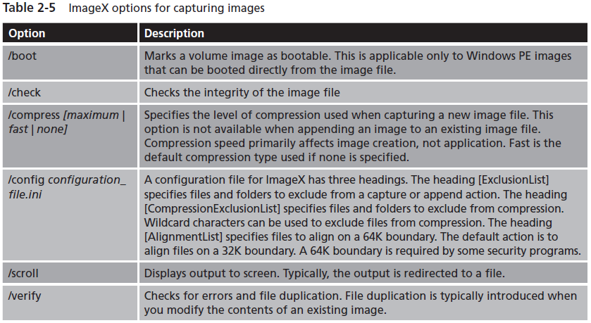
ImageX (cont'd.)
Found on page 83 in book

Slide 58
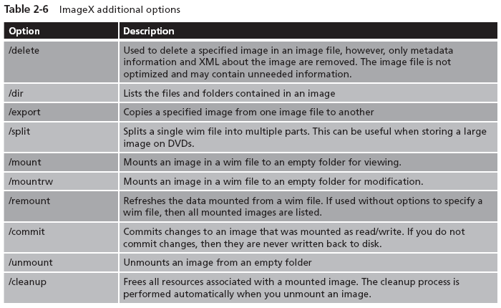
ImageX (cont'd.)
Found on page 68 in book
Other image management tasks

Slide 59
Image Maintenance
You can include a preconfigured installation of Windows 7 and applications
Requires you to apply software updates to those images
Some common scenarios for using DISM:
  Add device drivers
  Apply Windows updates
  Enable Windows features
  Identify the need for application updates

Slide 60
Windows PE Boot Media Creation
Operating system on a hard drive cannot be running while an image is being taken or applied
Steps to create a Windows PE boot CD
  Run copype.cmd to create the folder structure with the necessary files
  Copy winpe.wim to ISO\Sources\boot.wim
  Copy ImageX.exe and other desired files to the ISO folder
  Run oscdimg.exe to create an ISO file that you can burn to CD
  Burn the ISO file to CD or DVD

Slide 61
Summary
Windows 7 has many enhancements that make deployment easier
Primary ways to install Windows 7 are DVD boot, distribution share, and image-based
Clean installations are preferred over upgrade installations by most network administrators
Windows 7 can perform a dual boot with almost any other operating system

Slide 62
Summary (cont'd.)
Windows Easy Transfer is a graphical wizard that migrates user settings and files from an old computer to Windows 7
Attended installation requires you to answer questions during the installation
Unattended installation uses an answer file to pass configuration to Setup
During a basic installation, the windowsPE, offlineServicing, specialize, and oobeSystem configuration passes are performed

Slide 63
Summary (cont'd.)
WSIM is used to create answer files, add device drivers or packages to an answer file, create a configuration set, or apply offline updates to a Windows 7 image
Sysprep is used to prepare computers for imaging
ImageX is used to capture, modify, and apply WIM images
DISM is used to maintain Windows 7 images
You can create a bootable CD, DVD, or USB drive to perform imaging operations

